Slide 1
Student Analysis Case Study
Analysed using python (pandas, numpy)
by Eryk Suchan
Data Source:
https://www.kaggle.com/datasets/jayaantanaath/student-habits-vs-academic-performance

Slide 2
Outline
Introduction
Data Sources
Documentation of cleaning and manipulation
Summary of Data Analysis
Key Visualisations and Findings
Recommendations

Slide 3
Introduction
My name is Eryk and I am responsible for the analysis of this data. I have been studying data analysis programs such as SQL and Python over the past year. With my learnt skills, I am able to present the following dataframe. The project has been created using pandas, numpy in google colab.
The chosen analysis is ‘Student habits vs academic performance’ due to the fact that this allowed me to reach a variety of conclusions regarding a wide range of topics which will be present in the following slides.
Personal Task: To analyse the difference in learning between male and female students and how much of an impact the current technology can have on their education.
Problem: How can I reflect this data onto myself and my style of learning?

Slide 4

Data Sources Used
The dataset for this analysis was downloaded from Kaggle via Public Domain. The dataset was made available through Kaggle.
This is a simulated dataset exploring how lifestyle habits affect academic performance in students. With 1,000 synthetic student records and 15+ features including study hours, sleep patterns, social media usage, diet quality, mental health, and final exam scores, it’s perfect for ML projects, regression analysis, clustering, and data viz. Created using realistic patterns for educational practice.
This data is deemed credible as it operated under a public domain with data made available.

Slide 5

Documentation of cleaning & manipulation

Slide 6

Dataset was downloaded and stored with appropriate file names.
The titles of the columns were renamed in order for my working environment to be easily accessible.
To check if the Libraries are working fine, simple .loc (select) query has been used to highlight all of the male students.
Python Libraries Such as Pandas and Numpy as well as Google Colab were the tools employed for this analysis.
The dataset has been checked for any duplicates or empty spaces. If any, those would be deleted appropriately.

Slide 7
Summary Continued.
Summary analysis was carried out on the dataset and the following statistics were taken:
- Female/Male Social Media hours from ages 18-24 ( academic ages)
- Total study hours by gender during a day period.
- Amount of students that work/don’t work and their study hours
- Hours of sleep vs Attendance
- Attendance vs Exam Scores
- Exam Scores vs Gender
- Gender vs Age ( the total amount of Female and Male students)

Slide 8
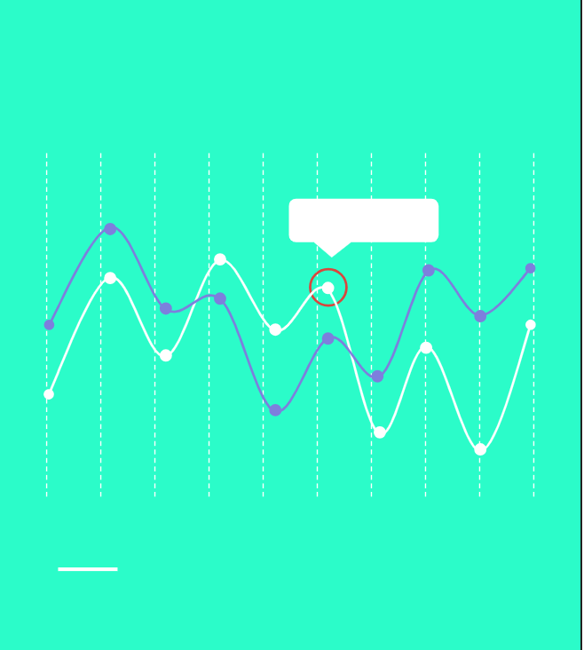
Key Findings

Slide 9
Key Findings
From the dataset, I have gathered that the total amount of social media hours that Females use is 1204 hours across 481 individuals whereas males is 1192 hours across 481 individuals.
The total amount of hours that Females study is 32.6 across 5 random students & the total amount that males study is 32.4 across 5 random students.
The data suggests that 23 year olds spend the most time in front of social media with just over 7 hours a day.
Students who work spend much less time studying ( 79% less).
The average result for the average hours of sleep is 6.5 hours daily and the students attendance on average is 83%.

Slide 10
Key Findings 2
The average attendance percentage of students is 83% and their average exam score is 78%.
The minimum number of exam score that Females receive is 18.4% whereas their mean is 69.7%. Moreover, the Males on the other hand, have a minimum exam score of 23.1% with their mean being lower at 69.3%.
The overall exam score across all students assessed is higher for Females than for Males. This suggests that Females learn slightly more effectively than the Male students.

Slide 11
Key Visualisations
Visuals from the datasets and analysis

Slide 12
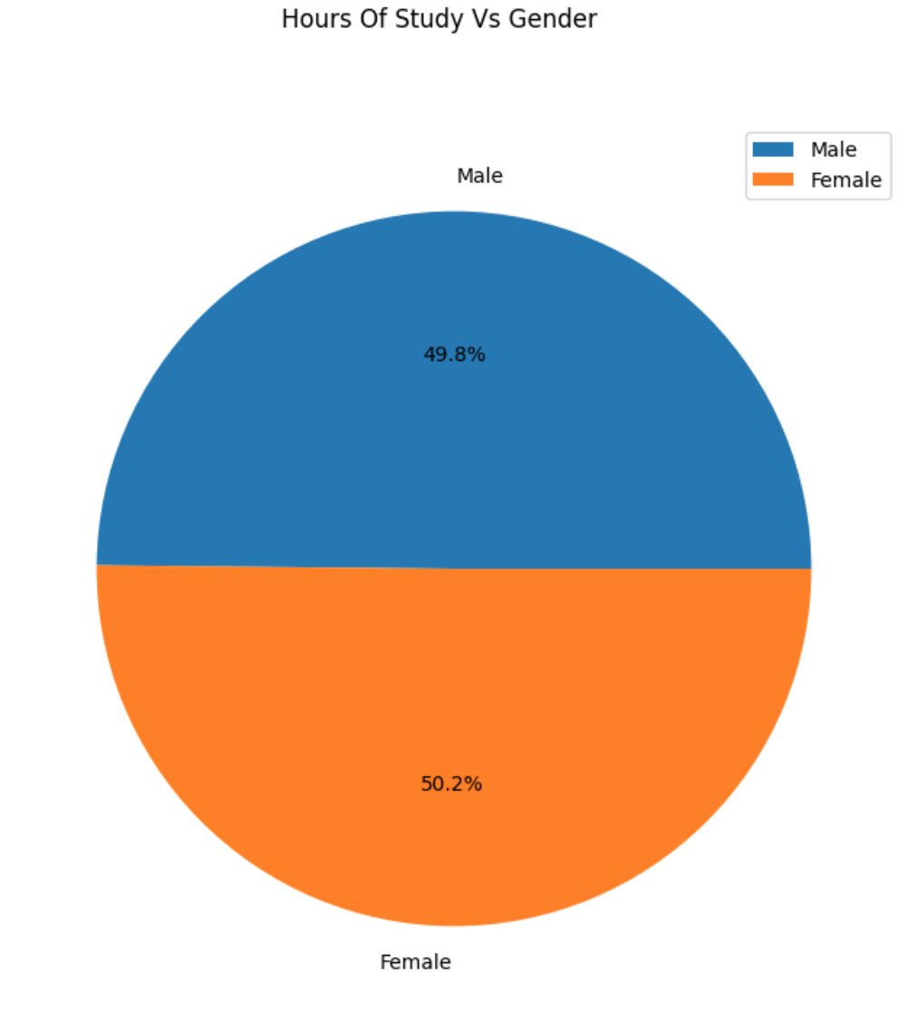
Chart 1: Hours of Study per Gender
The pie chart shows the amount of study being done by both Females and Males across the whole DataFrame. This result suggests that Females tend to spend more time studying per day than Males do. The more learning they do, the better results they get.

Slide 13
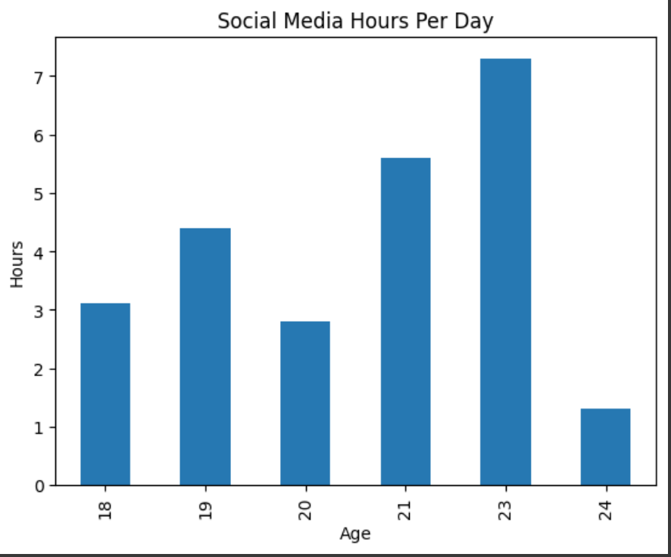
Chart 2: Social Media Hours Per Day / Per Age
The following bar chart showcases that age 23 spends the most time in front of the social media. This might be in regards to the fact that students tend to be more relaxed and laid back with their university studies. The major chances can be seen at age 24. This is because the graduation is coming up and students have to concentrate on their studies more.

Slide 14
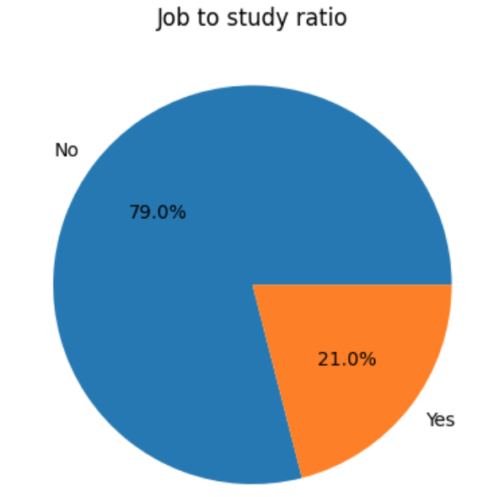
Chart 3: Does work decrease the amount of study being done?
Chart 3 has been done to showcase how much does part-time work do to the students study dedication. 79% of students that work part-time DON’T study in their free time after work. On the other hand, 21% of students in question has said ‘YES’ to studying after work. This is a major difference and students have to ask themselves a question, will my part-time work cause my drive to study to decrease and potentially get worse grades?

Slide 15
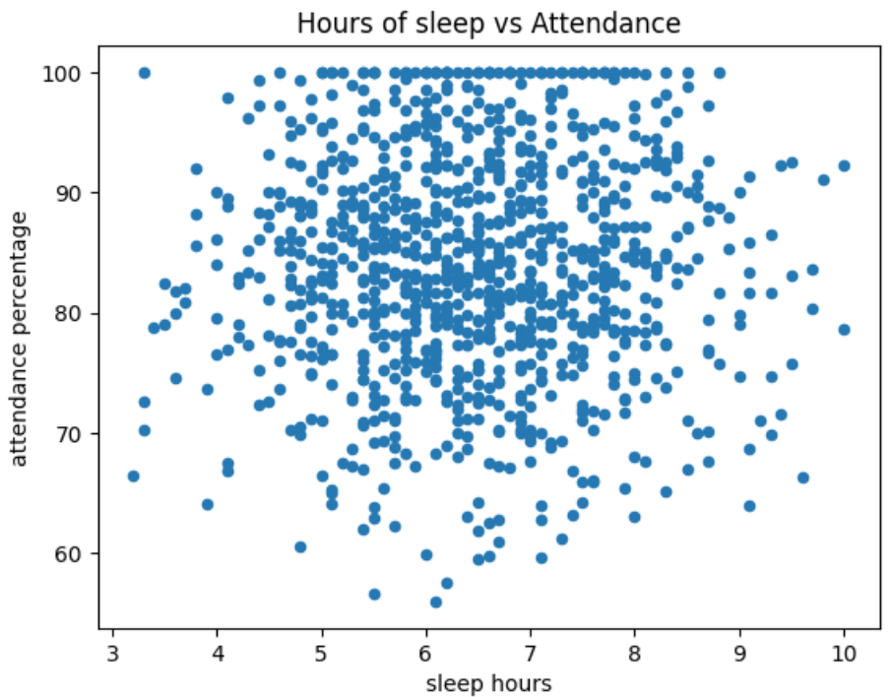
Chart 4: Hours of sleep Vs Attendance
The graph on the right indicates the amount of sleep hours students get and their attendance in class. From the pattern gathered, students tend to sleep on average 6.5 hours daily with their attendance being around 83%. The pattern of this scatter graph mainly is focused in the middle of both hours of sleep and attendance.

Slide 16
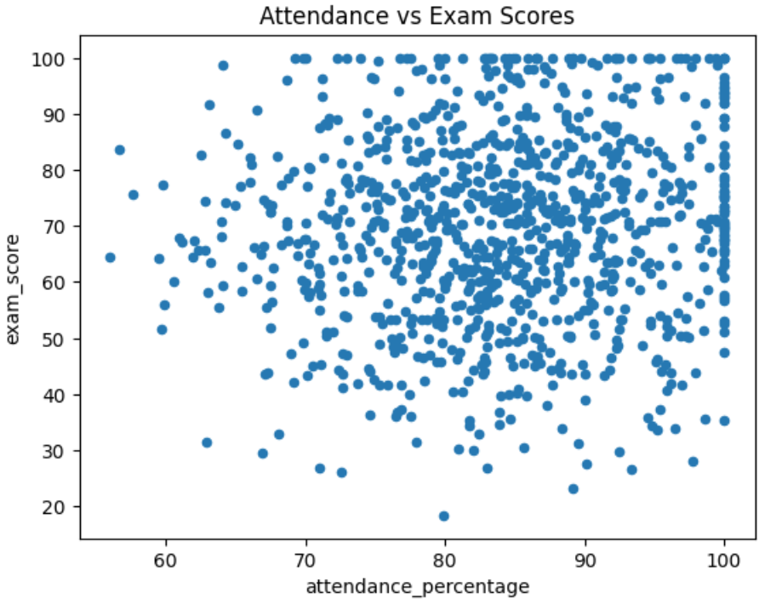
Chart 5: Does attendance at school has an impact on exam scores?
From chart 5, we can gather that attendance DOES play a vital role in students receiving a significantly better exam results. With the main pattern of this scatter graph being focused slightly to the right, positioning itself around 83% mark with the exam score being just over 78%. Plenty of factors play a vital part to the exam score but from what we can gather from this graph itself, attendance does matter!

Slide 17
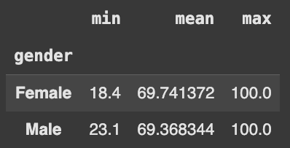
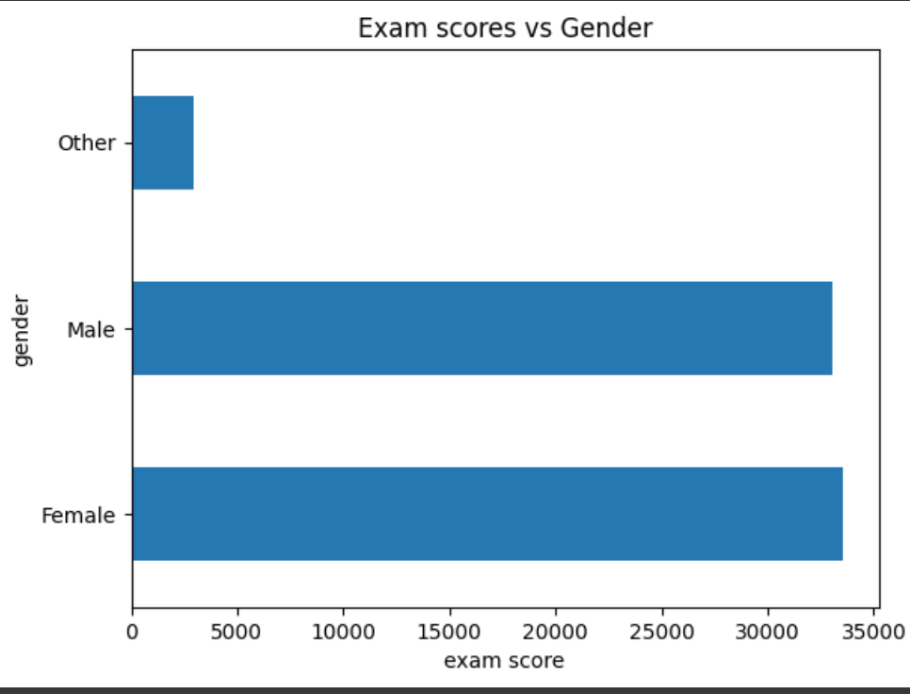
Chart 6: Exam Scores vs Gender
Fig 1
Figure 1 shows the min,mean and max number of results the students got within their exams. From what we can gather, the females have an overall higher mean standing ar 69.7 whereas the male students have a mean of 69.3, just slightly below.
Figure 2 confirms that the summarised exam score is higher for the females than the males. This could be related to the fact that male students spend 0.4% less time studying.
Fig 2

Slide 18
Recommendations
In response to my task and problem, the following are the concluding recommendations for me and other students to use to incorporate into everyday lives:
The biggest problem currently on the rise is the amount of social media hours that both males and females digest. In order to minimise this, students should change this time out for spending time with their family or using the Pomodoro method to focus more on their studies. The pomodoro method allows students to study for 25 minutes and then 10 minute break for a quick snack or stretching and so on. This greatly reduces deconcentration amount and allows students to stay on track.
The amount of part time jobs can be reduced to weekends only as during the week, the brain is focused more on studies. If a student works during the week, the amount of energy they will have after the work will be little to none so minimising the amount of hours worked as a student can definitely help to get better exam grades.
Increasing the amount of sleep hours will help with concentration levels and energy to go to university/college. Students should realise how important lectures are. Sometimes one crucial tip from the teacher, can change the perception of learning.
Students that are in the middle of their Graduate should minimise their amount of hours spent in front of social media platforms, especially 23 year olds. Being more productive by creating projects for the future or learning new skills can be much more beneficial than sitting in front of the social media platforms.

Slide 19
Message from me to me:
Over the past year, I’ve committed myself to a journey of self-discipline, resilience, and continuous learning. Teaching myself programming from the ground up has not only deepened my appreciation for education but has also shown me the power of consistency, focus, and self-sacrifice in the pursuit of something greater.
My proudest achievement isn’t a certificate or a finished project—it’s becoming a better version of myself. It’s the quiet victory of building strong habits, dedicating 4 to 5 hours each day to learn and grow, and showing up even when it’s hard.
Working on projects that challenge me to use various programming languages, tools, and design techniques has only confirmed how deeply I love this path. The sense of fulfillment I get from creating something out of nothing—from solving problems and bringing ideas to life—is something I find difficult to put into words.
Thank you for reading this far. In doing so, you’ve become a small, meaningful part of my journey.

Slide 20
Thank you!

